Slide 1
Lecture 6: virtual memory
Prof Yotov
CS6233
Slides by Prof Sandoval
Some slides derived from : Prof Dolan-Gavitt and William Stallings
Thanks !!

Slide 2
Memory Management Techniques
(Stallings book, page 315)
Notes:
Table 7.2 Memory Management Techniques

Slide 3
Virtual Memory
Recall from last time – segmentation is no longer used to separate processes' memory from one another
Instead, virtual addressing is used
Each memory access no longer refers directly to physical memory, but instead is mapped to some actual physical address
Notes:
There are many problems with segmented memory: ???
So we want virtual memory
We are gonna have some mapping table

Slide 4
Virtual Memory Terminology ((Stallings book)
Notes:
Table 8.1 defines some key terms related to virtual memory.

Slide 5
Hardware and Control Structures
Two characteristics fundamental to memory management:
all memory references are logical addresses that are dynamically translated into physical addresses at run time
a process may be broken up into a number of pieces that don’t need to be contiguously located in main memory during execution
If these two characteristics are present, it is not necessary that all of the pages or segments of a process be in main memory during execution
Notes:
Comparing simple paging and simple segmentation, on the one hand, with fixed and
dynamic partitioning, on the other, we see the foundation for a fundamental breakthrough
in memory management. Two characteristics of paging and segmentation
are the keys to this breakthrough:
1. All memory references within a process are logical addresses that are dynamically
translated into physical addresses at run time. This means that a process may be swapped in and out of main memory such that it occupies different
regions of main memory at different times during the course of execution.
2. A process may be broken up into a number of pieces (pages or segments) and
these pieces need not be contiguously located in main memory during execution.
The combination of dynamic run-time address translation and the use of
a page or segment table permits this.
Now we come to the breakthrough. If the preceding two characteristics are
present, then it is not necessary that all of the pages or all of the segments of a process
be in main memory during execution. If the piece (segment or page) that holds the
next instruction to be fetched and the piece that holds the next data location to be
accessed are in main memory, then at least for a time execution may proceed.

Slide 6
Execution of a Process
Operating system brings into main memory a few pieces of the program
Resident set
portion of process that is in main memory
An interrupt is generated when an address is needed that is not in main memory
Operating system places the process in a blocking state
Continued . . .
Notes:
For now, we can talk in general
terms, and we will use the term piece to refer to either page or segment, depending
on whether paging or segmentation is employed. Suppose that it is time to bring a
new process into memory. The operating system begins by bringing in only one or
a few pieces, to include the initial program piece and the initial data piece to which
those instructions refer.
The portion of a process that is actually in main memory
at any time is defined to be the resident set of the process. As the process executes,
things proceed smoothly as long as all memory references are to locations that are
in the resident set. Using the segment or page table, the processor always is able to
determine whether this is so. If the processor encounters a logical address that is
not in main memory, it generates an interrupt indicating a memory access fault. The
operating system puts the interrupted process in a blocking state.

Slide 7
Implications
More processes may be maintained in main memory
only load in some of the pieces of each process
with so many processes in main memory, it is very likely a process will be in the Ready state at any particular time
A process may be larger than all of main memory
Notes:
There are two implications, the second more startling than the first, and both lead to improved
system utilization:
1. More processes may be maintained in main memory. Because we are only
going to load some of the pieces of any particular process, there is room for
more processes. This leads to more efficient utilization of the processor because
it is more likely that at least one of the more numerous processes will be
in a Ready state at any particular time.
2. A process may be larger than all of main memory. One of the most fundamental
restrictions in programming is lifted. Without the scheme we have
been discussing, a programmer must be acutely aware of how much memory
is available. If the program being written is too large, the programmer must
devise ways to structure the program into pieces that can be loaded separately
in some sort of overlay strategy. With virtual memory based on paging
or segmentation, that job is left to the OS and the hardware. As far as the
programmer is concerned, he or she is dealing with a huge memory, the size associated
with disk storage. The OS automatically loads pieces of a process into
main memory as required.

Slide 8
Real and Virtual Memory
Real memory
main memory, the actual RAM
Virtual memory
memory on disk
allows for effective multiprogramming and relieves the user of tight constraints of main memory
Notes:
Because a process executes only in main memory, that memory is referred to
as real memory . But a programmer or user perceives a potentially much larger memory—
that which is allocated on disk. This latter is referred to as virtual memory .
Virtual memory allows for very effective multiprogramming and relieves the user
of the unnecessarily tight constraints of main memory.

Slide 9
Thrashing
A state in which the system spends most of its time swapping process pieces rather than executing instructions
To avoid this, the operating system tries to guess, based on recent history, which pieces are least likely to be used in the near future
Notes:
To understand what the key issue is, and why virtual memory was a matter
of much debate, let us examine again the task of the operating system with respect
to virtual memory. Consider a large process, consisting of a long program plus a
number of arrays of data. Over any short period of time, execution may be confined
to a small section of the program (e.g., a subroutine) and access to perhaps only one
or two arrays of data. If this is so, then it would clearly be wasteful to load in dozens
of pieces for that process when only a few pieces will be used before the program is
suspended and swapped out. We can make better use of memory by loading in just a
few pieces. Then, if the program branches to an instruction or references a data item
on a piece not in main memory, a fault is triggered. This tells the operating system
to bring in the desired piece.
Thus, at any one time, only a few pieces of any given process are in memory,
and therefore more processes can be maintained in memory. Furthermore, time is
saved because unused pieces are not swapped in and out of memory. However, the
operating system must be clever about how it manages this scheme. In the steady
state, practically all of main memory will be occupied with process pieces, so that the
processor and operating system have direct access to as many processes as possible.
Thus, when the operating system brings one piece in, it must throw another out. If it
throws out a piece just before it is used, then it will just have to go get that piece again
almost immediately. Too much of this leads to a condition known as thrashing : The
system spends most of its time swapping pieces rather than executing instructions.
The avoidance of thrashing was a major research area in the 1970s and led to a variety
of complex but effective algorithms. In essence, the operating system tries to guess,
based on recent history, which pieces are least likely to be used in the near future.

Slide 10

Principle of Locality
Program and data references within a process tend to cluster
Only a few pieces of a process will be needed over a short period of time
Therefore it is possible to make intelligent guesses about which pieces will be needed in the future
Avoids thrashing
Notes:
This reasoning is based on belief in the principle of locality , which was introduced
in Chapter 1 (see especially Appendix 1A). To summarize, the principle of
locality states that program and data references within a process tend to cluster.
Hence, the assumption that only a few pieces of a process will be needed over a short
period of time is valid. Also, it should be possible to make intelligent guesses about
which pieces of a process will be needed in the near future, which avoids thrashing.

Slide 11
Support Needed for Virtual Memory
For virtual memory to be practical and effective:
hardware must support paging and segmentation
operating system must include software for managing the movement of pages and/or segments between secondary memory and main memory
Notes:
Thus we see that the principle of locality suggests that a virtual memory
scheme may work. For virtual memory to be practical and effective, two ingredients
are needed. First, there must be hardware support for the paging and/or segmentation
scheme to be employed. Second, the operating system must include software
for managing the movement of pages and/or segments between secondary memory
and main memory.

Slide 12
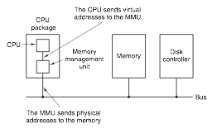
Notes:
At the hardware level it will sort of look like this

Slide 13
Paging
Virtual memory is broken up into fixed-sized units (commonly, 0x1000 bytes (4096 decimal)) called pages
Page sizes can vary though:
32-bit x86 supports 4KB and 4MB pages
64-bit x86 supports 4KB, 2MB, and 1GB pages
The underlying physical pages of memory are called page frames
Notes:
Store more or fewer mappings.
It doesn’t have to be 4K.
X86 supports different sizes
4MG you only to store less than 4KB
64bit give you even more options

Slide 14
Page Size
The smaller the page size, the lesser the amount of internal fragmentation
however, more pages are required per process
more pages per process means larger page tables
for large programs in a heavily multiprogrammed environment some portion of the page tables of active processes must be in virtual memory instead of main memory
the physical characteristics of most secondary-memory devices favor a larger page size for more efficient block transfer of data
Notes:
An important hardware design decision is the size of page to be used.
There are several factors to consider. One is internal fragmentation. Clearly, the
smaller the page size, the lesser is the amount of internal fragmentation. To optimize
the use of main memory, we would like to reduce internal fragmentation. On the
other hand, the smaller the page, the greater is the number of pages required per
process. More pages per process means larger page tables. For large programs in
a heavily multiprogrammed environment, this may mean that some portion of the
page tables of active processes must be in virtual memory, not in main memory.
Thus, there may be a double page fault for a single reference to memory: first to
bring in the needed portion of the page table and second to bring in the process page.
Another factor is that the physical characteristics of most secondary-memory devices,
which are rotational, favor a larger page size for more efficient block transfer of data.

Slide 15
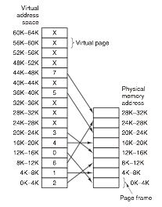
Notes:
Each process can have their own address space.
You can have two processes with

Slide 16
Page Faults
What happens if we try to access a page that is not mapped?
The MMU notices, and we raise a CPU exception called a page fault
Control is passed to the OS (via the usual interrupt/exception handling mechanism) to decide what to do
Kill the process (segmentation fault)
Find some physical page to map to it
Notes:
Handled by the same mechanism that handles interrupts, system calls, etc

Slide 17
Programs Bigger than Memory
Note that this gives us a way to have programs that don't all fit into memory at once
We can just map in the parts of the program we're using right now
If we hit code or data that isn't mapped, we can swap some other page to disk and update the mappings
Notes:
This might not be much of an issue, yet, but it was more before.
We start up the prog and we map the first 4K chunk.
Drawing of locality.

Slide 18
Types of Page Fault
Minor page fault – can be serviced by just creating the right mapping
Major page fault – must load in a page from disk to service
Segmentation fault – invalid address accessed; can't service so we usually just kill the program

Slide 19
Page Tables
The MMU has to maintain information about the virtual->physical mapping
In the simplest case, this could be a simple array that stores the physical page number for each virtual page number
The virtual address would then be split into two parts: an index into the mapping table, and then the offset within the page
Notes:
Page table mappings in RAM

Slide 20
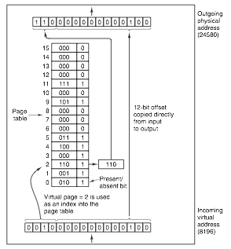
Notes:
One part is the 4 bit index into the page table.

Slide 21
Why 12 bits?

Slide 22
Why 12 bits?
2 ^12 = 4096
Notes:
How do you know what’s your max address space

Slide 23
Real Page Tables
In reality, this is very inefficient if the virtual address space is expected to be sparse (not many mapped pages)
Instead, multi-level page tables are used
The virtual address now has multiple indexes
This allows us to only allocate tables for portions of the space that are used
Remember: the page tables themselves are stored in memory!
Multilevel pages animation.

Slide 24

Page Table Entries
Modified – has this page been written to?
If so, we will need to write to disk before evicting
Referenced – has anyone used this page?
Caching disabled – used if physical page is used for device I/O

Slide 25
Protection
Because the OS can give processes different virtual address spaces, we have already solved the problem of isolation
But we may want to protect processes from themselves in some cases:
Detect programmer errors before they do damage
Prevent attacks that exploit software vulnerabilities

Slide 26
Protection
Simplest protection is to mark pages as read-only or read/write
Now, if someone attempts to modify read-only code or data, a page fault will occur
Some processors (in x86-land, starting with the AMD64 in 2003) have a bit to prevent code from being executed on a certain page
This has been called variously the NX bit, the XD bit, Data Execution Prevention (DEP)
The idea is to prevent buffer overflows from being exploitable –the attacker won't be able to run his own code because it will be in a data region
Notes:
This is just data not code.

Slide 27
Translation Lookaside Buffer
Walking the page table hierarchy each time memory is accessed gets very expensive
If we have to do 2 table lookups for every memory access, we've just made memory 3x slower
Instead, the CPU keeps a small set of mappings that it can translate directly without consulting the page tables
Animation: http://cs.uttyler.edu/Faculty/Rainwater/COSC3355/Animations/pagingtlb.htm
Notes:
If you reference one byte, you will reference another set of bytes

Slide 28
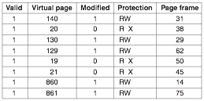
TLB Example
Notes:
This is in the CPU
When do you think the TLB will be invalidated? At context switch.

Slide 29
Software TLB Management
In some architectures (e.g. SPARC, MIPS), the TLB is managed by software
TLB entries are explicitly loaded by the OS
If we look up an address and it's not in the TLB (a TLB miss), we raise a TLB fault
The OS then has to fill in the missing TLB entry

Slide 30
Software TLB Management
Why manage the TLB explicitly instead of letting hardware do it?
The MMU can be much simpler, which saves space on the CPU that can be used for other things
Flexibility – the OS can choose its own algorithms for which TLB entries to evict and add
But: this is generally slower than hardware-managed TLBs

Slide 31
TLBs and Context Switching
TLBs map a virtual address to a physical one
But once we change to a new process, these mappings are no longer valid, and a TLB flush occurs
This makes context switching more expensive – the first few memory accesses a process makes will have to be serviced by walking the page tables

Slide 32
Tagged TLBs
On some architectures, each TLB entry can be associated with a tag that says what address space it belongs to
Now we don't have to flush the TLB when switching address spaces
This can help make context switching faster – some TLB entries might still be valid when we switch back to a process

Slide 33
Inverted Page Tables
Instead of using one page table entry per virtual page, keep one entry per physical page frame
Benefit: page tables are proportional to size of physical memory, not virtual address space
But now we have to search the entire list to look up a mapping
TLB can help here, but TLB misses are still very expensive
Used in PowerPC, UltraSPARC, Itanium
Notes:
From the physical to the virtual instead
Optimization tricks: sorted,

Slide 34
Hashed Page Tables
We can reduce the time it takes to lookup a page in an inverted table by using a hashed page table
Basically just a hash table where the keys are virtual addresses and the values are the page directory entries
Inverted and hashed page tables are common on (non-x86) 64-bit architectures
Notes:
Amortized constand time lookup

Slide 35
Page Table Overhead Calculations
Using page tables has some overhead
Just how much?
Depends on the exact paging scheme used

Slide 36
Page Table Overhead Calculations
"Worst" case:
single-level page table, 64-bit virtual address space, 4KB pages, 4 byte PTEs
2⁶⁴ / 4096 * 4 bytes = 2⁵² * 2² = 2⁵⁴ bytes = 16 petabytes of memory used for pages
2⁵⁰ = Petabyte or 1024 terabytes or million gigabytes
And that's just for one process!
Notes:
Increase the page size,

Slide 37
Virtual Address Translation in x86
We will, for now, consider only:
32-bit x86
4KB and 4MB ("super") pages
Notes:
So not:
32-bit PAE (allows using more than 4GB of RAM on a 32-bit machine)
64-bit mode

Slide 38
x86 Paging Basics
x86 virtual address translation uses a two-level page table:
A top-level page directory stores pointers to the page tables
Page tables contain the actual page table entries (PTEs) referring to physical page frames
The current mappings in use are determined by the value of the CR3 CPU register, which stores the physical address of the page directory

Slide 39
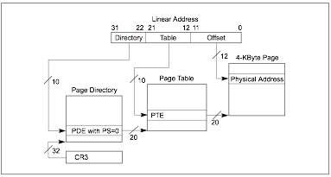
x86 Paging
Notes:
The first 10 bits tell you which index in the page directory you are looking for
The second 10 bits tell you which index in the table entry you are looking for
12 bit offset tells you which byte

Slide 40
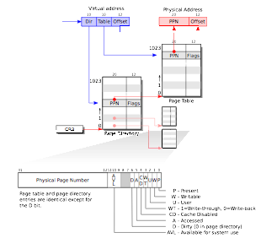

Slide 41
x86 PDEs and PTEs
The entries in a page directory and a page table have an almost identical format
Each 32-bit
The basic structure:
Physical address of a page table (for PDEs) or memory page (for PTEs)
Protection, caching, etc. flags
A bit to indicate present/not present

Slide 42
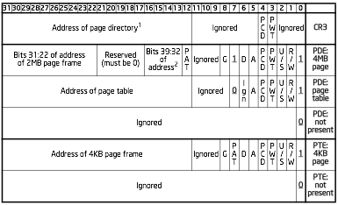

Slide 43
Worked Example
Let's take an arbitrary address I got from running xv6: 0x8010c608
CR3 = 0x003ff000
In binary:
10000000000100001100011000001000

Slide 44
Worked Example
1000000000 0100001100 011000001000
Directory index = 1000000000 = 512
Table index = 0100001100 = 268
Offset = 011000001000 = 1544

Slide 45
Page Directory
Address
Entry
0x003ff000: 0x00000000
0x003ff004: 0x00000000
0x003ff008: 0x00000000
0x003ff00c: 0x00000000
0x003ff010: 0x00000000
[...]
0x003ff800: 0x003fe027
0x003ff804: 0x003fd027
0x003ff808: 0x003fc027
0x003ff80c: 0x003fb027
0x003ff810: 0x003fa027
0x003ff814: 0x003f9027
[...]
CR3 = 0x003ff000
Directory index = 512
Note:
0x003ff000 + 512 * 4
= 0x003ff800
Notes:
Why is this number odd?
They are all valid

Slide 46
Page Directory Entry
0x003fe027
0000 0000 0011 1111 1110 0000 0010 0111
Address of page table: 0x3fe000
(A) Accessed: Yes
(PCD) Cache disabled: No
(PWT) Write through caching: No
(U/S) User-accessible: Yes
(R/W) Read/Write: Yes
(P) Present: Yes

Slide 47
Page Table
Address
Entry
Address of page table:
0x3fe0000
0x003fe000: 0x00000063
0x003fe004: 0x00001003
0x003fe008: 0x00002003
0x003fe00c: 0x00003003
0x003fe010: 0x00004003
[...]
0x003fe430: 0x0010c063
0x003fe434: 0x0010d063
0x003fe438: 0x0010e063
0x003fe43c: 0x0010f063
0x003fe440: 0x00110063
0x003fe440: 0x00111063
[...]
Table index = 268
Note:
0x003fe000 + 268 * 4
= 0x003fe430

Slide 48
Page Table Entry
0x0010c063
00000000000100001100000001100011
Address of physical page: 0x10c000
(G) Global: No
(PAT) PAT page: No
(D) Dirty: Yes
(A) Accessed: Yes
(PCD) Page Cache Disable: No
(PWT) Page Write Through: No
(U/S) User-accessible: No
(R/W) Read/Write: Yes
(P) Present: Yes

Slide 49
Physical Page
Address of page:
0x10c000
0000000: 0000 0000 0000 0000 0000 0000 0000 0000 ................
0000010: 0000 0000 0000 0000 0000 0000 0000 0000 ................
0000020: 0000 0000 0000 0000 0000 0000 0000 0000 ................
0000030: 0000 0000 0000 0000 0000 0000 0000 0000 ................
0000040: 0000 0000 0000 0000 0000 0000 0000 0000 ................
0000050: 0000 0000 0000 0000 0000 0000 0000 0000 ................
0000060: 0000 0000 0000 0000 0000 0000 0000 0000 ................
0000070: 0000 0000 0000 0000 0000 0000 0000 0000 ................
0000080: 0000 0000 0000 0000 0000 0000 0000 0000 ................
0000090: 0000 0000 0000 0000 0000 0000 0000 0000 ................
00000a0: 0000 0000 0000 0000 0000 0000 0000 0000 ................
[...]
0000600: 8029 1180 8202 0000 28c6 1080 524a 1080 .)......(...RJ..
0000610: 3a87 ff07 0000 0000 38c6 1080 b448 1180 :.......8....H..
0000620: 2824 1180 0100 0000 38c6 1080 8038 1080 ($......8....8..
0000630: 0000 4080 0000 008e 48c6 1080 2138 1080 ..@.....H...!8..
0000640: 0000 0000 54c6 1080 f87b 0000 0000 0000 ....T....{......
0000650: 0000 0000 0000 0000 0000 0000 0000 0000 ................
0000660: 0000 0000 d483 1080 0000 0000 0000 0000 ................
0000670: 5c1f 1080 6721 1080 ff23 1080 8924 1080 \...g!...#...$..
0000680: 635e 1080 7555 1080 4d67 1080 5b65 1080 c^..uU..Mg..[e..
0000690: 0000 0000 0200 0000 0100 0000 0100 0000 ................
00006a0: acc8 1080 4c03 1180 0000 0000 e803 0000 ....L...........
00006b0: ad03 0000 c800 0000 1e00 0000 0200 0000 ................
00006c0: 2000 0000 3a00 0000 0000 0000 0000 0000 ...:...........
00006d0: 0000 0000 0000 0000 0000 0000 0000 0000 ................
Offset = 1544 = 0x608
Data: 0x8010c628

Slide 50
Super Pages
If the Page Size Extension (PSE) bit is set in CR4, we can optionally have entries in the page directory point directly to 4MB pages
This can be beneficial because it reduces paging overhead (only one level of lookup, more data mapped)

Slide 51
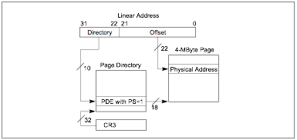
Translation with Super Pages

Slide 53
Running the Numbers
Basics: super pages use 21 bits for offset because 2²¹ = 4MB
How many entries in a 4KB page table?
1024 entries = 4MB addressed by one page table
So each page directory entry addresses 4MB of memory whether it points to a page table or a super page
How many page directory entries?
We want to address 4GB of memory => 4GB/4MB = 1024
That's why the available sizes are 4KB and 4MB pages

Slide 54
Paging Overhead in x86
Supposing we have mapped 512MB worth of virtual address space using 4KB pages
Each page table covers 4MB of memory
So space required: sizeof(1 page directory) + (512MB / 4MB) * sizeof(1 page table) = 4KB + 128 * 4KB = 4KB + .5 MB = ~0.503 MB

Slide 55
Max Overhead
4KB + 1024 page tables * 4KB / table = ~4MB
What if we just used a one-level page table with 4KB pages?
(4GB / 4KB) entries * 4 bytes / entry = 4MB
What if we used 4MB pages everywhere?
(4GB / 4MB) entries * 4 bytes = 4096 bytes = 4KB

Slide 56
Virtual Address Translation in xv6
xv6 mostly uses 4KB pages (one page table per process, and one page table specifically for the scheduler)
Early on in boot, it uses entrypgdir, which creates 4MB mappings
Notes:
In boot it uses superpages.

Slide 57
entrypgdir
main.c
// Boot page table used in entry.S and entryother.S.
// Page directories (and page tables), must start on a page boundary,
// hence the "__aligned__" attribute.
// Use PTE_PS in page directory entry to enable 4Mbyte pages.
__attribute__((__aligned__(PGSIZE)))
pde_t entrypgdir[NPDENTRIES] = {
// Map VA's [0, 4MB) to PA's [0, 4MB)
[0] = (0) | PTE_P | PTE_W | PTE_PS,
// Map VA's [KERNBASE, KERNBASE+4MB) to PA's [0, 4MB)
[KERNBASE>>PDXSHIFT] = (0) | PTE_P | PTE_W | PTE_PS,
};
entry.S
# Set page directory
movl $(V2P_WO(entrypgdir)), %eax
movl %eax, %cr3
Notes:
Page aligned.
Page directories and page tables have to exist at a location that ends in 12 zeros
PG talbe entry
The 0th entry in that table, equals address zero, ored with the present bit, writable, page size bit
Ps = 4mb page.

Slide 58
entrypgdir
0x80000000 >> 22 = 512
main.c
// Boot page table used in entry.S and entryother.S.
// Page directories (and page tables), must start on a page boundary,
// hence the "__aligned__" attribute.
// Use PTE_PS in page directory entry to enable 4Mbyte pages.
__attribute__((__aligned__(PGSIZE)))
pde_t entrypgdir[NPDENTRIES] = {
// Map VA's [0, 4MB) to PA's [0, 4MB)
[0] = (0) | PTE_P | PTE_W | PTE_PS,
// Map VA's [KERNBASE, KERNBASE+4MB) to PA's [0, 4MB)
[KERNBASE>>PDXSHIFT] = (0) | PTE_P | PTE_W | PTE_PS,
};
entry.S
# Set page directory
movl $(V2P_WO(entrypgdir)), %eax
movl %eax, %cr3
Notes:
2GB Boundary

Slide 59
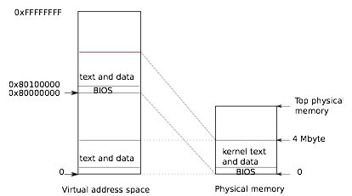
0x80400000

Slide 60
xv6 Process Page Tables
entrypgdir suffices for early boot, but once boot is done xv6 sets up a more complicated page table
I/O space
Read-only space for kernel code and r/o data
Kernel writeable data & memory

Slide 61
kmap
// This table defines the kernel's mappings, which are present in
// every process's page table. (vm.c)
static struct kmap {
void *virt;
uint phys_start;
uint phys_end;
int perm;
} kmap[] = {
{ (void*)KERNBASE, 0, EXTMEM, PTE_W}, // I/O space
{ (void*)KERNLINK, V2P(KERNLINK), V2P(data), 0}, // kern text+rodata
{ (void*)data, V2P(data), PHYSTOP, PTE_W}, // kern data+memory
{ (void*)DEVSPACE, DEVSPACE, 0, PTE_W}, // more devices
};
Notes:
0x8000 0000 => kernbase
PHYSTOP 0xE000000
This defines the addresses that OS uses.
I/O
R/O
3rd goes from data to the end of memory
Further up, more I/0

Slide 62
Implementing the Map
// Set up kernel part of a page table.
pde_t*
setupkvm(void)
{
pde_t *pgdir;
struct kmap *k;
if((pgdir = (pde_t*)kalloc()) == 0)
return 0;
memset(pgdir, 0, PGSIZE);
if (p2v(PHYSTOP) > (void*)DEVSPACE)
panic("PHYSTOP too high");
for(k = kmap; k < &kmap[NELEM(kmap)]; k++)
if(mappages(pgdir, k->virt, k->phys_end - k->phys_start,
(uint)k->phys_start, k->perm) < 0)
return 0;
return pgdir;
}
Notes:
Allocate a page of memory using kalloc.
Do a little sanity check.
Map the data structures.
Calls mappages on each entry.

Slide 63
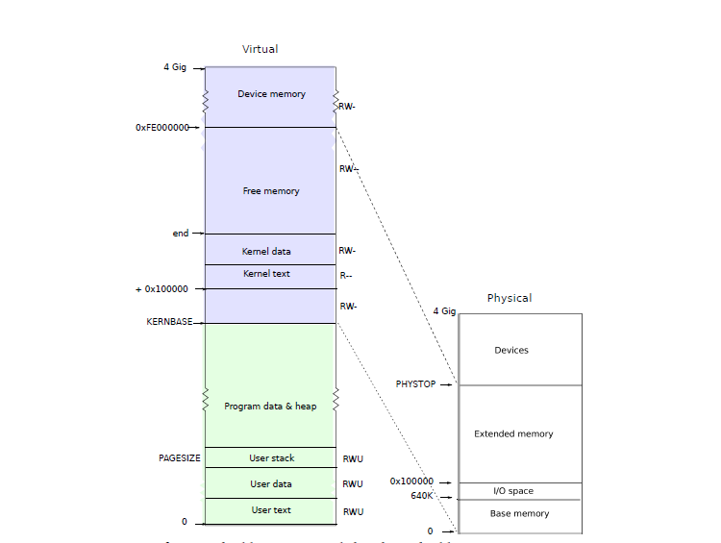
Notes:
Kalloc pulls memory out of the linked list we saw
Physical addresses != RAM because you could have physical addresses that get mapped to devices.
Write to the network address card, will be mapped to another

Slide 64
Creating the First Process Address Space
// Load the initcode into address 0 of pgdir.
// sz must be less than a page.
// #define PGSIZE 4096
void
inituvm(pde_t *pgdir, char *init, uint sz)
{
char *mem;
if(sz >= PGSIZE)
panic("inituvm: more than a page");
mem = kalloc();
memset(mem, 0, PGSIZE);
mappages(pgdir, 0, PGSIZE, v2p(mem), PTE_W|PTE_U);
memmove(mem, init, sz);
}
Note: only 4096 bytes given to process to start with
Notes:
Copy the init code to the memory
Init exectures the first system call

Slide 65
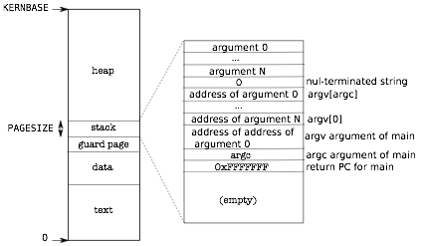
User-Space Layout
Layout set up in exec()
Notes:
Guard page is a page that is deliverately unmapped
You have gone over your stack
Then stack and heap.
Stack grows downward and we want to detect .
If your stack grows too much, we detect it in the guard page. One page size.

Slide 66
Guard Page
int
exec(char *path, char **argv)
{
[...]
// Allocate two pages at the next page boundary.
// Make the first inaccessible. Use the second
// as the user stack.
sz = PGROUNDUP(sz);
if((sz = allocuvm(pgdir, sz, sz + 2*PGSIZE)) == 0)
goto bad;
clearpteu(pgdir, (char*)(sz - 2*PGSIZE));
sp = sz;
[...]
}
Notes:
Implemented by the clearpteu function which basically makes the memory inaccessible and kills the process if it accesses it. ‘

Slide 67
Other Features of x86 Paging
When a page directory / page table entry is non-present, its format is unspecified by Intel
Notes:
Kernel address space is actually shared by all processes
The upper 2GB maps to the same physical pages.
Don’t flush the TLB. System calls are much faster
When you switch processes you switch CR3

Slide 68
Non-Present PDEs/PTEs
Since the CPU/MMU ignore these parts of the PDE/PTE, we can put store stuff in them
Common to use that space to store metadata about the non-present page
Example: if the page is available on disk, give info for how to retrieve it

Slide 69
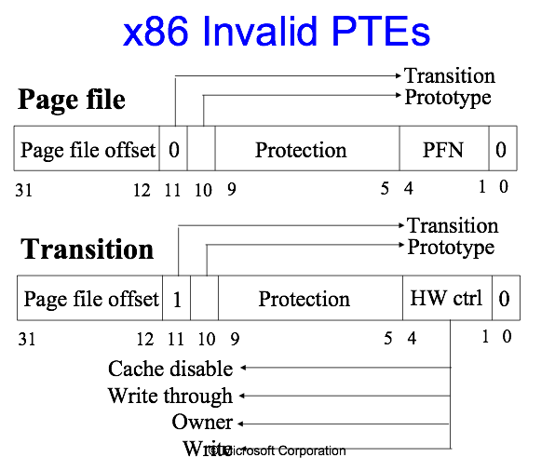
Windows Kernel
Diagram from David B. Probert / Microsoft Corp.
Notes:
Page file offset, some more protection flags

Slide 70
Paging Tricks
Having virtual address translation around lets us do lots of interesting things aside from basic process isolation
We'll go through a few applications people have found that make use of the paging hardware
Notes:
Isolate from each other.

Slide 71
Paging Tricks: Self-reference
Once we've put the processor into virtual address mode, we can only use virtual addresses
We need to be able to read and write page tables by referencing them through virtual addresses
Corollary: there must be a virtual address that maps back to the page directory itself

Slide 72
Paging Tricks: Self-reference
There is! In xv6, 0x80000000 + PhysAddr = VirtAddr (for low kernel memory only)
So if our page table is at physical address 0x3ff000, we can access it through 0x803ff000
Page tables have to be set up with this mapping:
Notes:
(qemu) xp 0x3ff000 + 512*4
00000000003ff800: 0x003fe027
(qemu) xp 0x003fe000 + 1023 * 4
00000000003feffc: 0x003ff003

Slide 73

Mapping page table at VA 0x803ff000 PA 0x3ff000
0x3ff000
Page Directory
Page Table
512
1023

Slide 74


Paging Tricks: Shared Memory
This one is pretty simple: just make virtual addresses of two processes point to the same physical memory
Process A
Physical Memory
Process B
Notes:
The don’t even have to be at the same virtual location
They don’t have to have the same permissions either
One way of IPC page table of one process mapped to another process

Slide 75
Paging Tricks: Copy-on-write
In UNIX, fork() creates a complete copy of the memory of another process
This is really inefficient – takes time to make the copy, wastes memory unless the new process makes changes

Slide 76
Paging Tricks: Copy-on-write
Instead: set up new process's mappings so they point to the same pages as the old process
But: make the mapping read-only using page permissions
Now if the process tries to write to one of its pages, we trap into the kernel (via a page fault), make a real copy, and then perform the write

Slide 77
Paging Tricks: Memory-mapped files
Normal way of reading a file: read() some data into a buffer, work on it, write() it back out
Instead we might want to map a file into memory – virtual address X+N would refer to the Nth byte in the file
We can again use paging for this – mark the pages corresponding to the file not present, then when someone tries to read them, read in from disk
We can write back changes either immediately (by making pages write protected) or when the process exits

Slide 78
Paging Tricks: Lazy Memory Allocation
Programmers are terrible people and sometimes allocate more memory than they really need
Example: allocating a large buffer for user input, then only using the very beginning
We'd like to not give them any more than they are actually using

Slide 79
Paging Tricks: Lazy Memory Allocation
Solution: make the system call that allocates memory essentially do nothing
But keep track of the fact that the process has allocated that virtual address range
If the process actually tries to use the memory, we will get a page fault and can then allocate a page on demand
If the pages are never touched, will never allocate

Slide 80
Paging Tricks: Lazy Memory Allocation
Beware – we can end up handing out more memory than we actually have this way
This is called overcommitting
Linux actually does this intentionally – malloc() almost never fails
But if you try to use all that memory, and the system runs out, the dreaded OOM-Killer will be invoked

Slide 81
Paging Tricks: Memory Breakpoints
When using a debugger, we might want to watch all changes to a particular piece of memory
E.g., to find out what code sets a global variable
x86 has hardware support for triggering a debugger when memory is accessed
But it's limited to just 4 memory locations
No good for monitoring larger data structures, e.g.

Slide 82
Paging Tricks: Memory Breakpoints
With a bit of help from the OS, we can do better
Any time we set a memory breakpoint, mark the entire page non-present (or read-only for memory write breakpoints)
Any access will trap into the OS, which can notify our debugger; when the debugger continues, the OS can finish handling the fault
For more details: How to do a million watchpoints: Efficient Debugging using Dynamic Instrumentation, Zhao et al.

Slide 83
Page Replacement Algorithms
If we can't fit everything in memory, eventually we will have to choose something to evict and write to disk
As with scheduling algorithms, this is a well-studied area and there are lots of strategies
This general principle shows up any time we have a limited-size cache – strategies described here apply to all of them

Slide 84
The "Optimal" Algorithm
At the time of a fault, consider the set of pages in memory
Given the code executing, they will each be referenced some number of instructions from now
To choose one to evict, just pick the one that's furthest from being referenced

Slide 85
The "Optimal" Algorithm
“Prediction is very difficult, especially about the future.”
– Niels Bohr
Problem: requires the OS to predict the future
Still, it's useful as a goal to work toward
We can benchmark other algorithms by how close they get to being optimal

Slide 86
Not Recently Used
We saw that page table entries contain bits that indicate whether the page was recently referenced or modified
We can use these bits to track which pages in memory have not been touched in a while
If a page hasn't been used in a while, it may be a good candidate for eviction

Slide 87
Implementing Not Recently Used
If we just rely on the CPU to mark referenced pages, over time eventually all pages would be referenced
Instead we can have the OS periodically clear the referenced bit (say, every clock tick)
Now if the referenced bit is 0, we know the page has not been referenced in at least one clock tick

Slide 88
First In, First Out (FIFO)
Simple algorithm:
Keep a linked list of pages in the order they were brought into memory
Tail is most recent, head is oldest
To evict, throw out the one at the head of the list
But: just because it's the oldest doesn't mean it's not being used!

Slide 89
Second Chance
Since we have the referenced bit available, we can do slightly better than FIFO
Before throwing out the oldest page, check if it's been referenced
If it has, clear the referenced bit and move it to the back of the list (as though it were a new page)
Keep looking through the list for something to evict

Slide 90
Clock
FIFO/Second Chance is inefficient because it may have to move around entries in the list often
As an optimization, we can imagine the pages arranged in a circle and keep a pointer (or index) indicating the position of the "clock hand"
Clock hand points to the oldest page – so now we can apply Second Chance by just updating the position of the clock hand

Slide 91
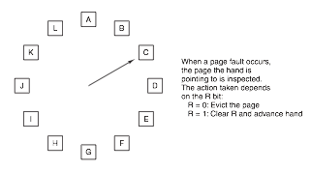
Clock

Slide 92
Least Recently Used (LRU)
Observation: pages that have been used a lot recently will probably be used again soon
So a good strategy might be: throw out the least recently used page
Very expensive to implement, though

Slide 93
LRU Implementation
One possibility: keep a list of pages (as with FIFO) and update it every time memory is referenced
Or, if we have extra hardware support – have hardware write a timestamp to the PTE every time every time a page is referenced
Neither of these is particularly appealing

Slide 94
Not Frequently Used (NFU)
We can (approximately) simulate LRU in software reasonably cheaply though
Maintain a list of counters, one per page
At each clock tick, if a page has been referenced, update its counter
Now we have a rough count of how often each page has been referenced over time

Slide 95
NFU Problems
A page might be referenced very often early on, and then never referenced again
But its count will remain high for a long time, preventing it from getting evicted
Meanwhile, a page that is referenced periodically (say every 20 ticks) may have a lower count but be in active use

Slide 96
Aging
To solve this problem, we can have counter values decay over time
Each clock tick, shift all counters right by one bit
Add in the reference bit as the leftmost bit
To evict, just choose the lowest counter value –because more recent references are in the more significant digits, they have greater weight

Slide 97
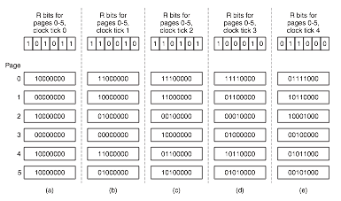
Aging

Slide 98
LRU Approximation
Aging is only an approximation of an actual LRU algorithm:
We don't get any information about how often something was referenced between two clock ticks
If our counter is N bits, our memory only extends back N clock ticks – so we can't distinguish how old things are past that point

Slide 99
Working Set
Most processes don't reference pages randomly scattered around memory
Instead, they have locality of reference – tend to reference only a small set of pages in a given time period
We call the set of pages currently being used by a process its working set
If you don't have enough memory to hold the working set, you will constantly be swapping – known as thrashing

Slide 100
Prepaging
When we want to bring a process back in after swapping it in, we have the option of doing nothing
When the process runs it will just continually page fault until all pages in the working set are in memory
Downside: each page fault requires some time to process – this is slow
Instead we can try to load the process's working set all at once; this is called prepaging

Slide 101
Size of the Working Set
The working set w(k,t) is more precisely defined as the number of pages referenced in the last k memory references at time t
If the process never accessed the same page twice, we would have w(k,t) = k
But because of reference of locality, w(k,t) stops increasing as k gets large

Slide 102
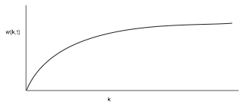
Working Set – Algorithm
We can take advantage of the fact that the working set of a process is roughly a fixed size after some warmup period

Slide 103
Tracking the Working Set
For performance, we would like to load the exact working set into the process when it's paged back in
In theory, we can just fix some value k and then track the pages touched in the last k memory references
But once again, doing anything on every memory reference is very very slow

Slide 104
Approximating the Working Set
As we saw with LRU, we may be able to make do with an approximation of the working set
For example: pages referenced in the last τ ms
Note: only track time when the process is actually executing – its current virtual time
Now we can take advantage of the CPU features that set the "referenced" bit automatically for us

Slide 105
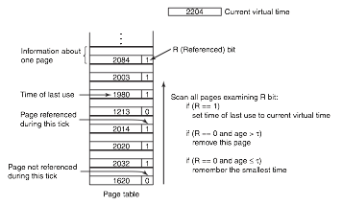
Working Set – Algorithm

Slide 106
Other Considerations
Global vs local page replacement
When we run our replacement algorithm, does it look just at the pages in the current process, or at pages allocated to all processes?
Load control
Sometimes we can't avoid thrashing
One possible solution – put some processes to sleep entirely, and hope that the working set of the remaining ones shrinks

